Slide 1


ENVIRE project
Modeling ESBL E. coli Spread from Agricultural Application of Broiler Manure to Watershed
30.09.2024

Slide 2
Environmental model general scheme
Recreational swimming
Farm module
Soil module
River module
Manure
Soil
Watershed
Fresh produce
Tap water

Slide 3

Soil module
Simulates the application and mixing with soil of manure in agricultural field
Quantifies the CFU/m², CFU/g*m² and the total CFU in the field
Estimates how E. coli concentrations decay in soil over 200 days based on a mean decay rate calculated from multiple studies

Slide 4
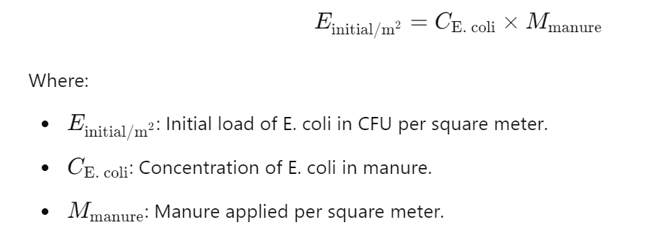
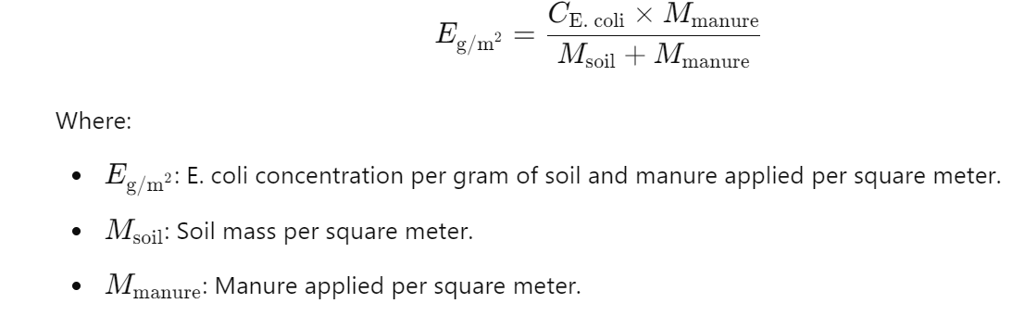
Soil Module
E. coli ∼N(1.6×104,0.02×104)
Mass (kg/m² ) = soil depth (m) × soil density (g/m³) ×1000
E. coli ∼N(1.6×104,0.02×104)
2000 g per square meter
CFU/g manure
CFU/g manure
Depth
Density
Manure per m²
Soil mass
2000 g per square meter
CFU/m²
CFU/g*m²

Slide 5
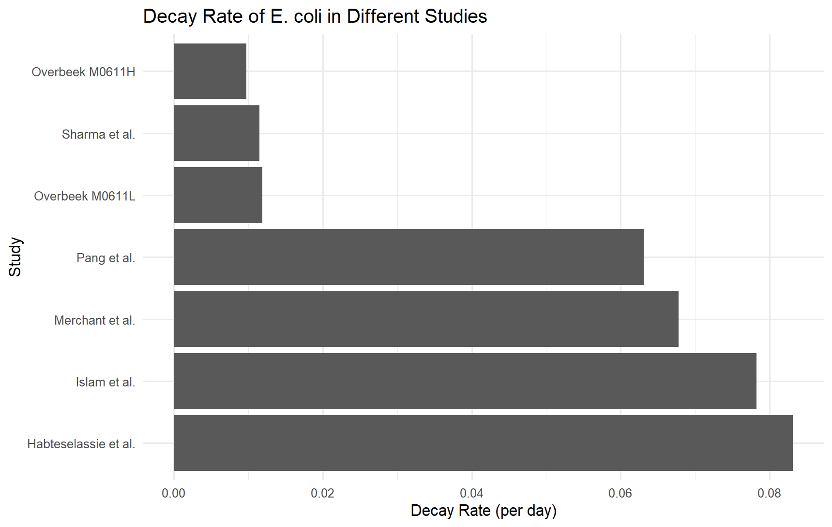
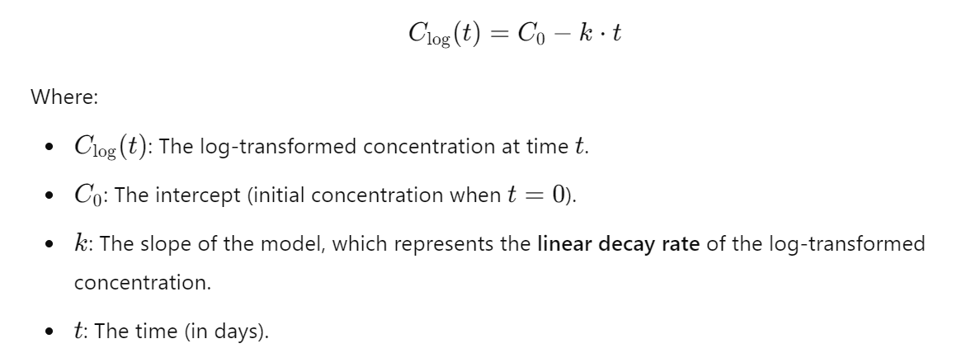
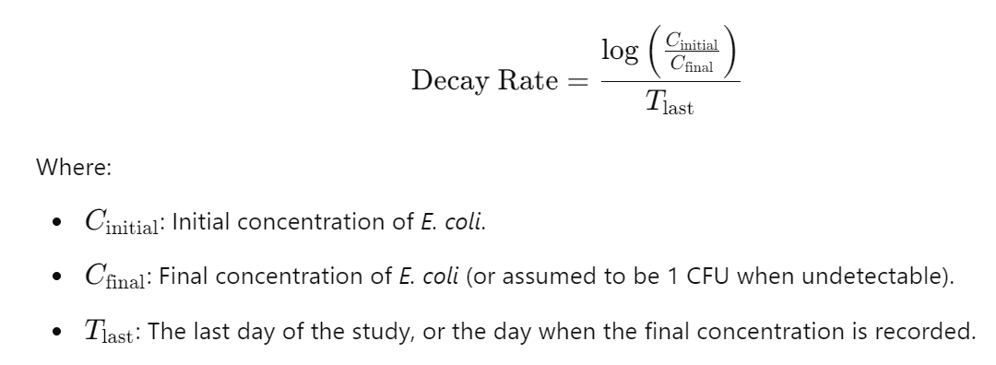
Decay
K (mean) = 0.4592791

Slide 6
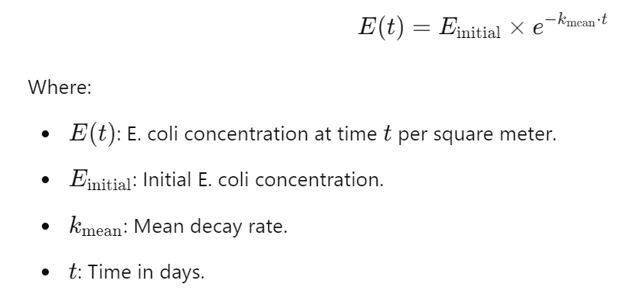
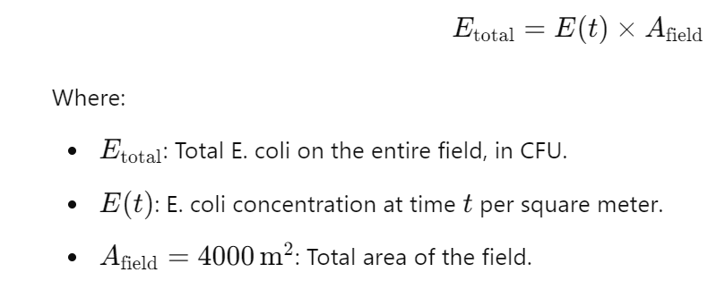
Soil Module
CFU/m²
Field size
Decay
Total CFU field
CFU/m² x Field area (m² )

Slide 7
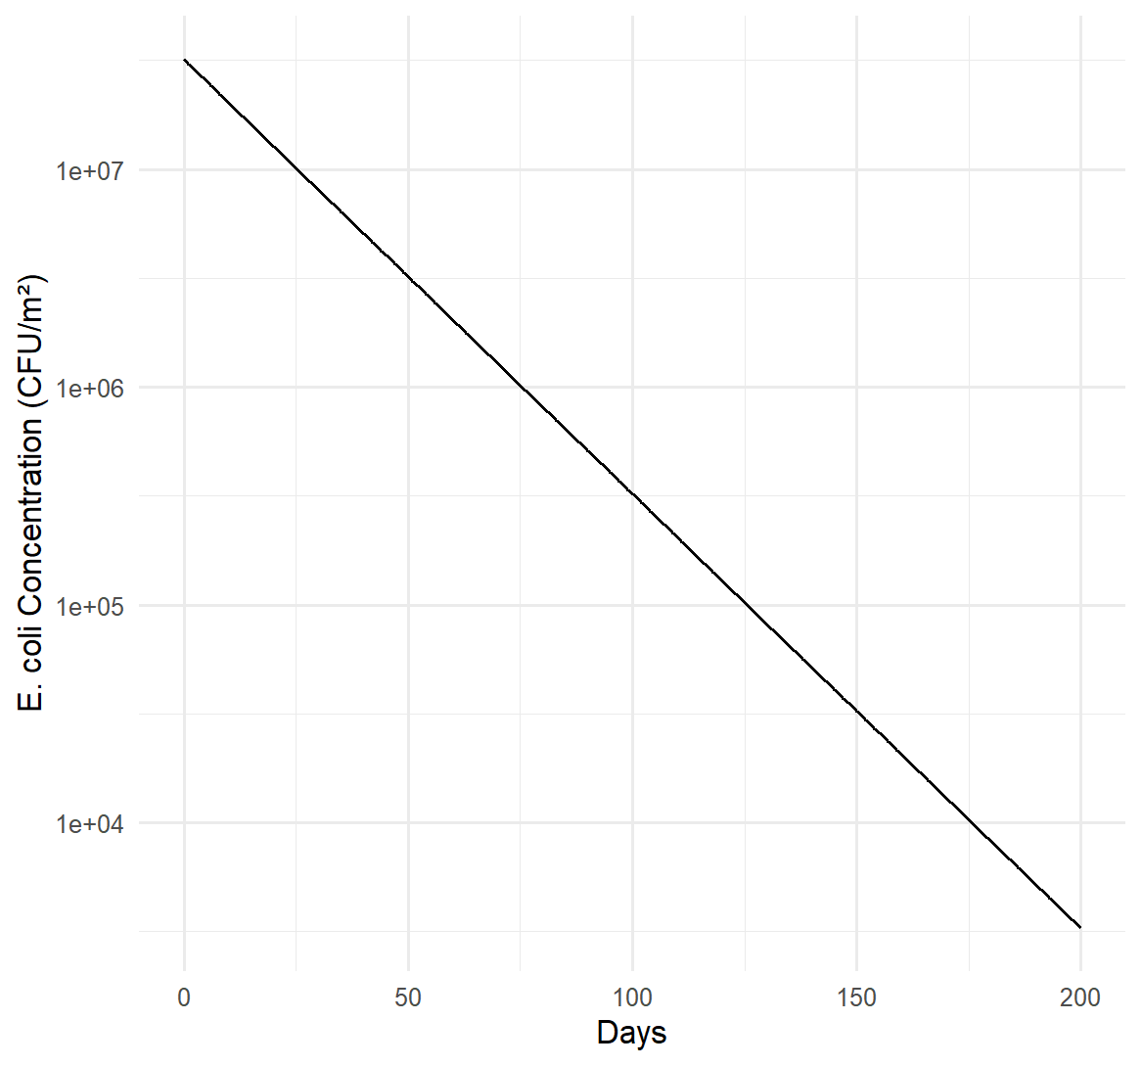
CFU per square meter
Day 200: 3279.149 CFU/m2 (std 40.04)

Slide 8
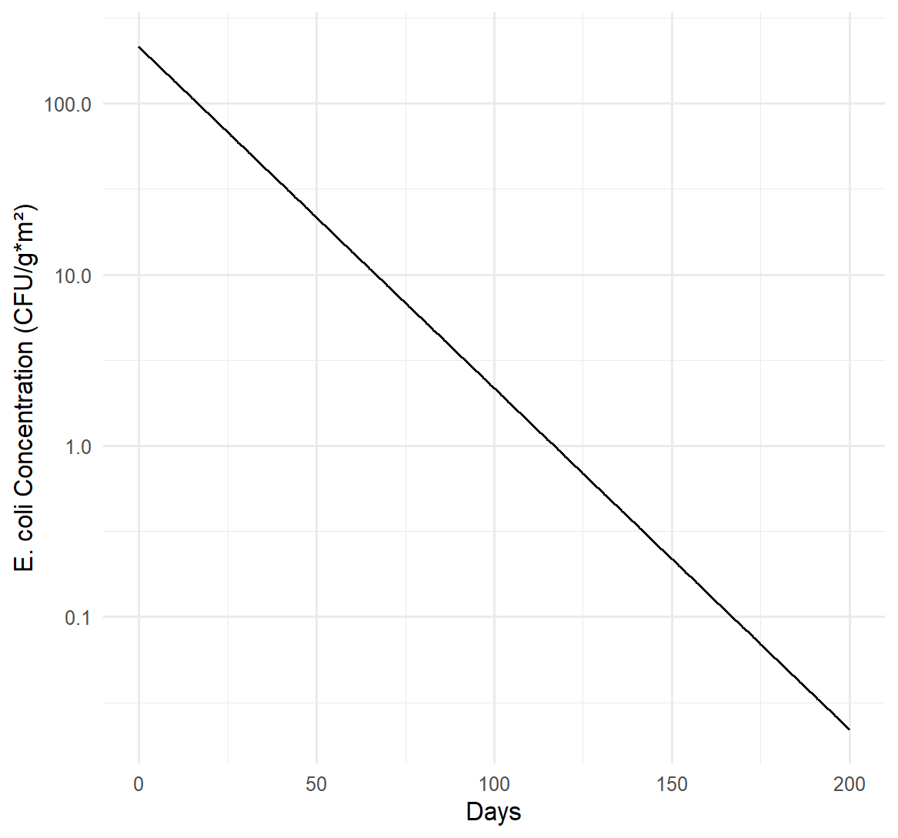
CFU per gram in a square meter
Farm module
10^4 CFU/g
After mixing
10^2 CFU/g
At day 200
10^-2 CFU/g

Slide 9

River module
Simulates the runoff of ESBL E. coli from the field to the watershed
Estimates how E. coli concentration decays in watershed over 200 days based on a environmental parameters
Quantifies the CFU/L in the watershed

Slide 10
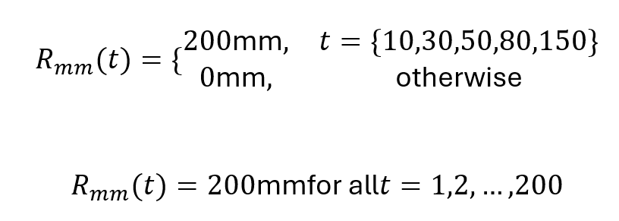
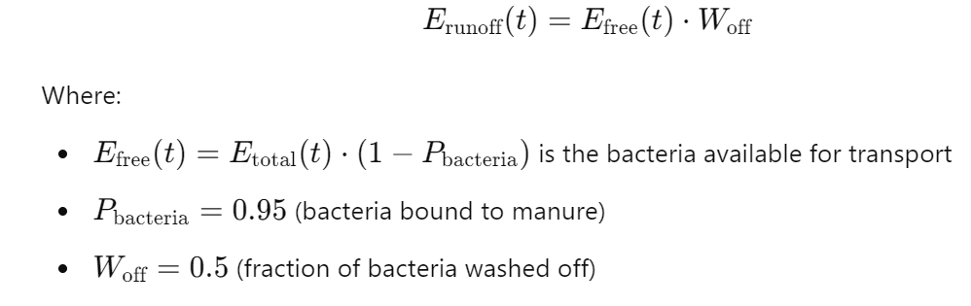

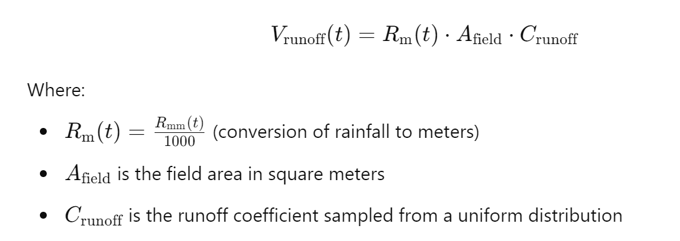
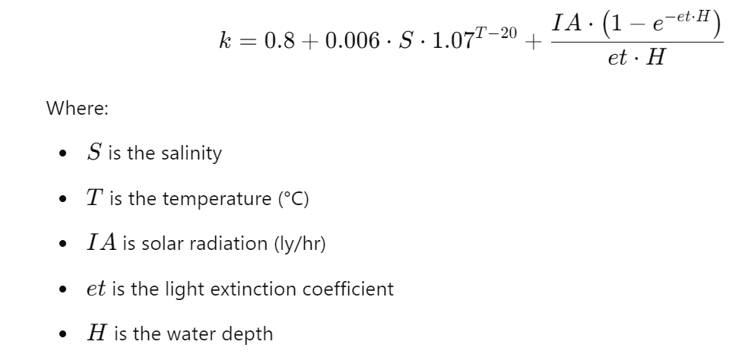

Rainfall (mm)
Total CFU field (CFU/m2)
E. Coli from the field (CFU)
Decay in water
Runoff (m³)
Bacteria in watershed (CFU/L)
Mancini’s decay

Slide 11
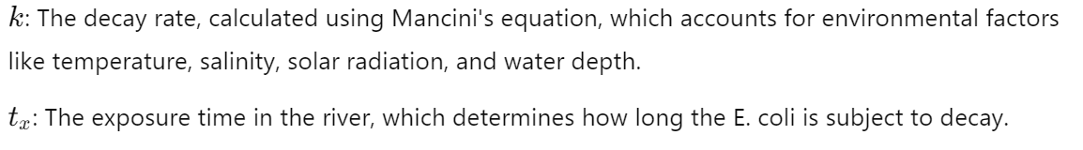
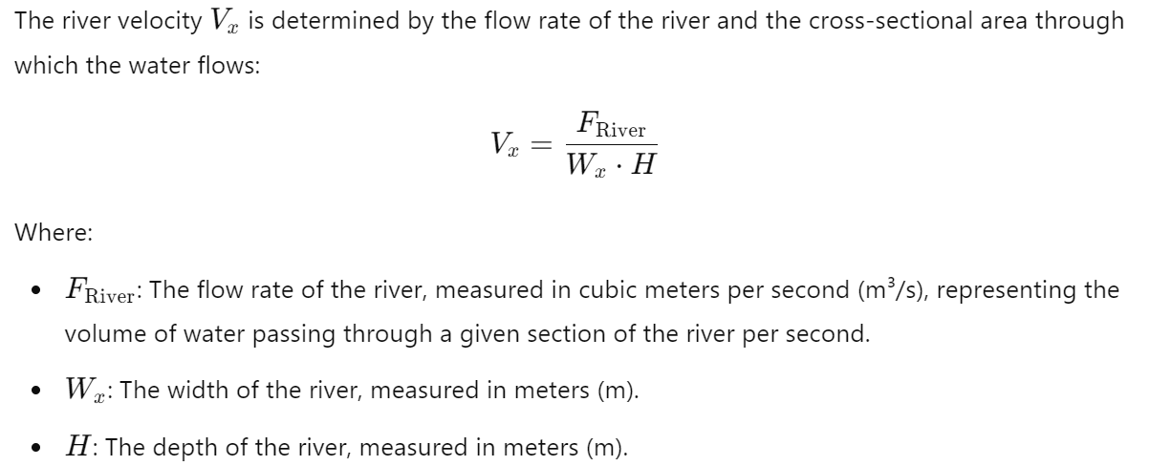
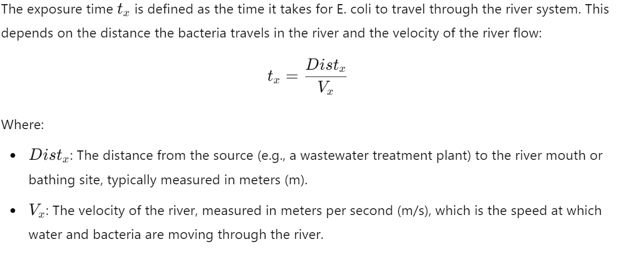
Decay in water

Slide 12
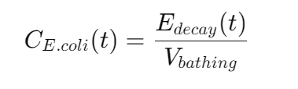
River Module
Rainfall (mm)
C watershed (CFU/L)
Total CFU field (CFU/m2)
E. Coli from the field (CFU)
Decay in water (CFU)
Runoff (m³)
Bacteria in watershed (CFU/L)
Mancini’s decay

Slide 13
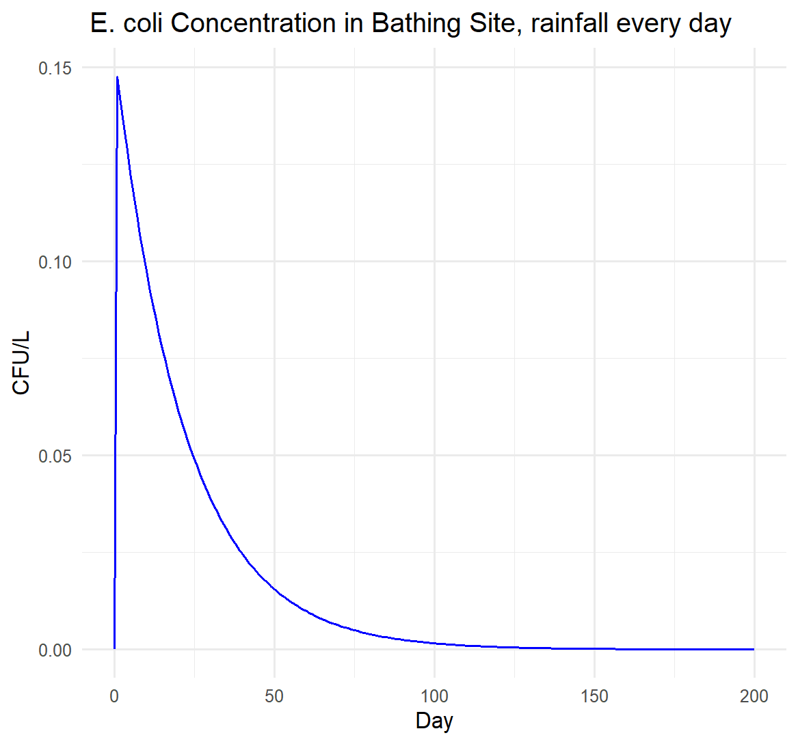
Results
Day 200: 1.5 x 10^-5 CFU/l

Slide 14
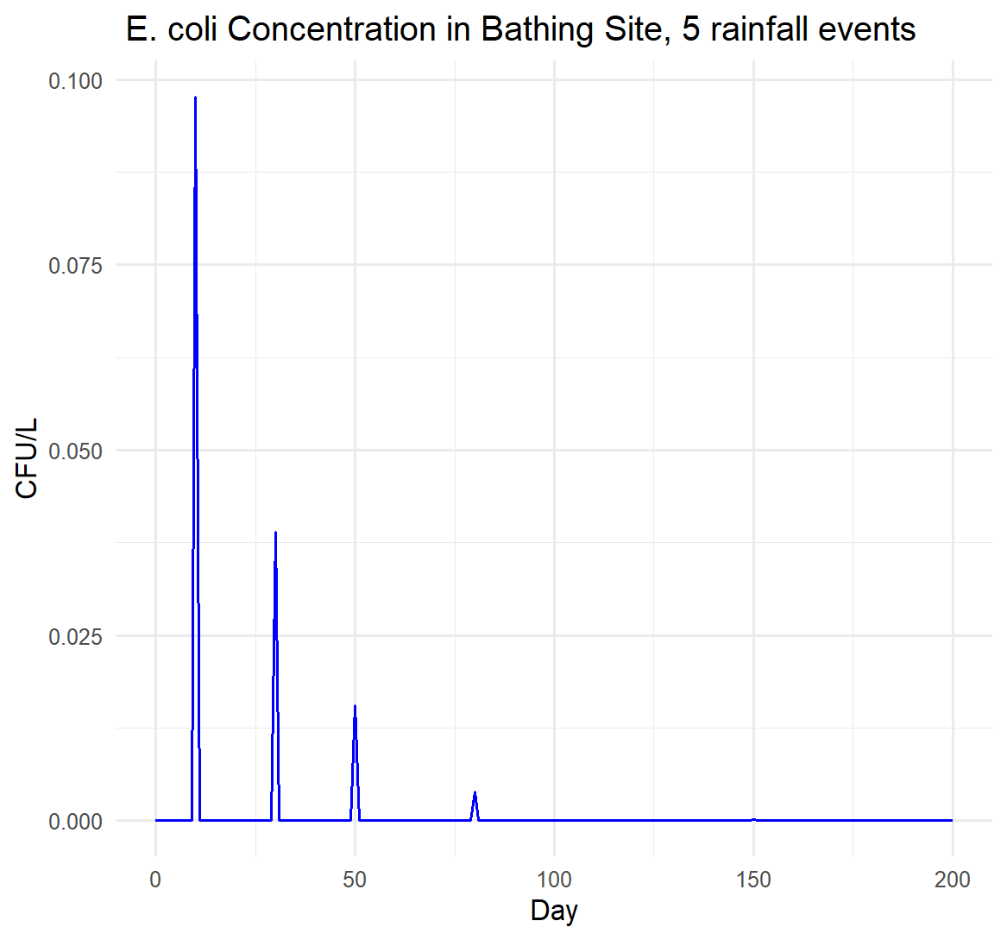
Results
CFU/L > 0 only on rainfall day

Slide 15
To do
Integration with the 3 pathways (Lettuce, swimming and tap water)
Use real life input parameters (watershed volume, field size, rainfall etc.)
Sensitivity analysis
????

